Slide 1
Robot Raconteur Training Seminar
Day 1
John Wason, Ph.D.
Wason Technology, LLC
16 Sterling Lake Rd, Tuxedo, NY, 10987
wason@wasontech.com

Slide 2
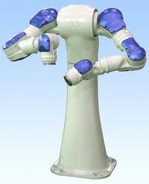
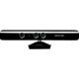
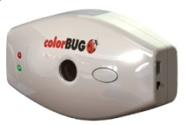
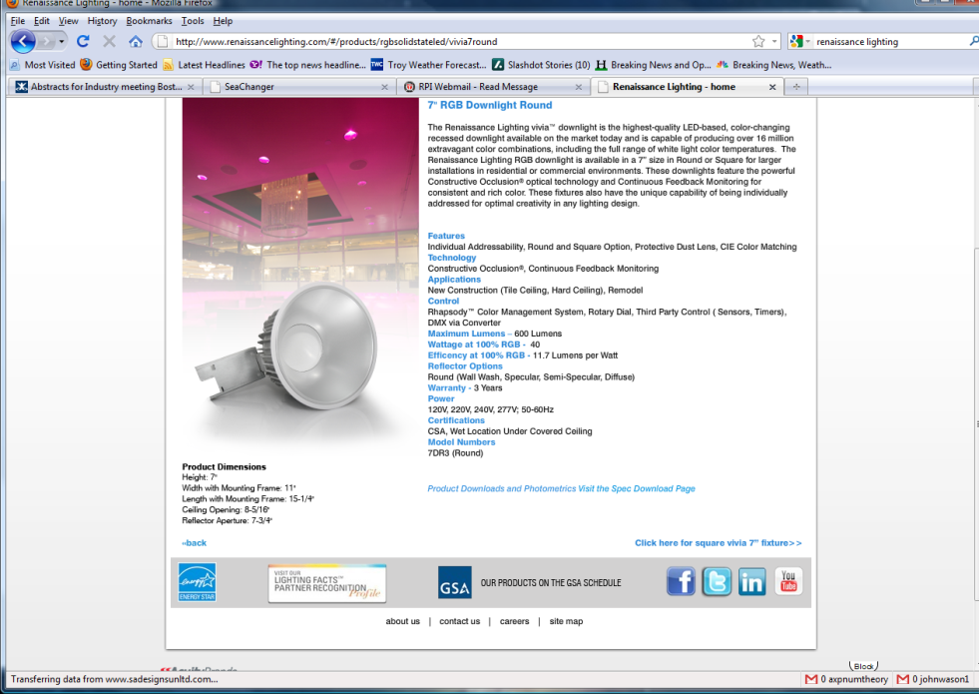
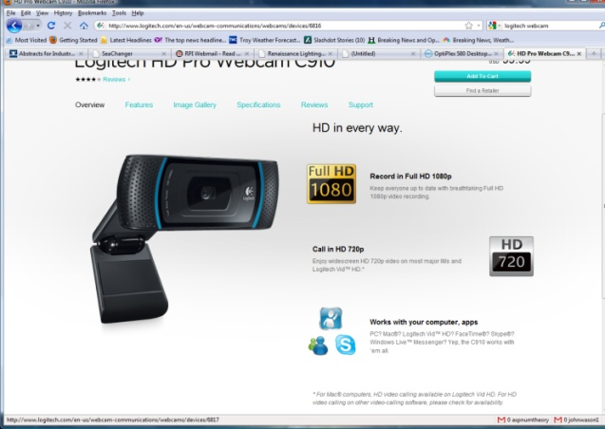
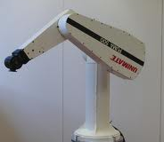
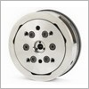
Motivation
A new robot and Kinect in the lab;
or multiple spectrally controllable lights, multiple spectral sensors, and multiple cameras;
or multiple robots with individual controllers and force/torque sensors …
How to get them to talk each other and program and control them?

Slide 3
Choices of Distributed Architectures
General Purpose (using Remote Procedure Call, RPC)
Distributed Component Object Model (DCOM) 🡺 .NET Remoting
Java Remote Method Invocation (RMI) 🡺 Common Object Request Broker Architecture (CORBA)
Robotics
Robot Operating System (ROS)
Data Distribution Service (DDS)
ZeroMQ/Protobuf (Ignition Transport)
- Expose functions or objects across network boundary
- Transparency achieved through serialization
- Some platform dependency

Slide 4
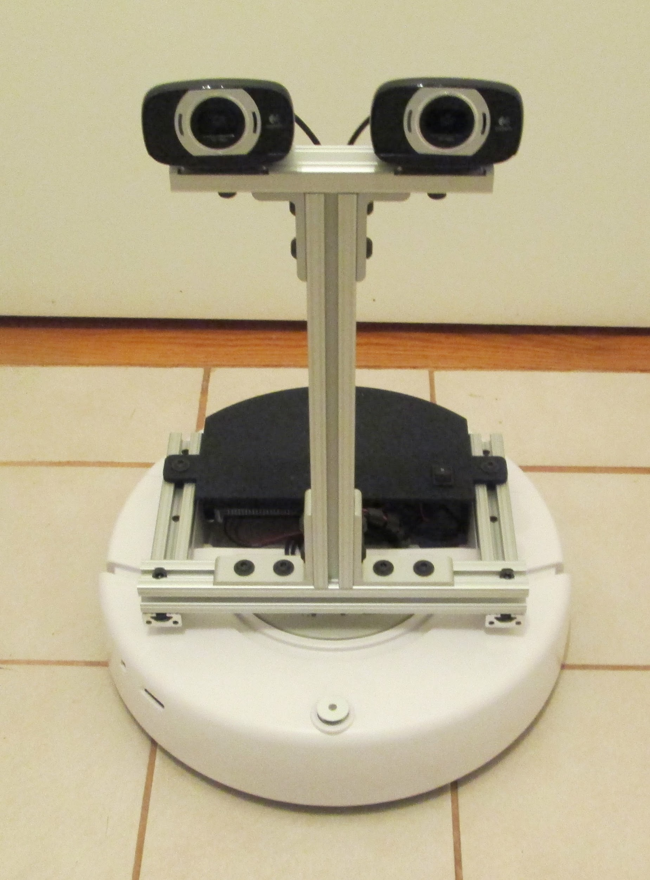
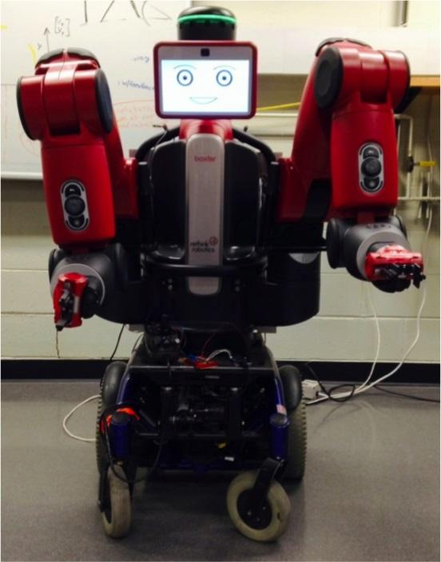
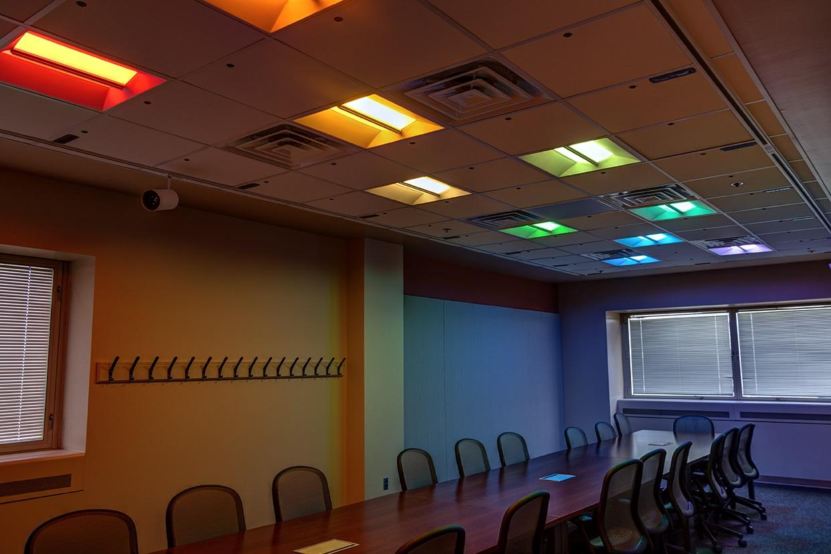
Introduction
Language, platform, and transport independent communication system for Robotics and Automation Systems
Compatibility
22 platforms/architectures
7 languages
5 transport technologies
“Plug-and-Play”, “Instant-On” capability
“Augmented Object-Oriented” model
Transactional, streaming, and “most recent”
Client-service and service-client
TLS, certificates, and password security
Compatible with Web and Cloud
Node and service discovery
Version 0.9 first open source release

Slide 5
Design Objectives
Peer-to-peer client-service communication
Ease of use
Minimal “boiler-plate” software development
Automatic type generation at runtime or design-time
Model similar to “object-oriented” systems
Rapid modification of services
Maximum compatibility between devices over long timespan
Decades, not months of compatibility
High performance, low latency
Industry standard security (TLS, certificates, etc.)
Automatic service discovery
Asynchronous operation
Minimal dependencies

Slide 6
Compatibility
Platforms/architectures
Windows (x86, x64)
Linux (x86, x86_64, ARM hard-float, ARM soft-float, PowerPC, MIPS
Mac OSX
Android (ARM, x86)
iOS
Web Browser (Chrome, IE, Edge, Firefox, Safari)
ASP.NET Web Server
Linux PREEMPT_RT
MathWorks xPC Target
Particle Photon embedded device
Arduino embedded device
Languages
C++, C#, Java, MATLAB, JavaScript, LabView
Transports
TCP, Local, USB, PCIe, QUIC
Compatibility constantly expanding, grey are experimental

Slide 7
Client-Service Model
Object Ref 1
Service: Base object reference with members, and references to other objects.
Service definition file: Define object and structure members
Supports try/catch error transmission across boundary
Object Ref 2
Client
Context
Object Ref 3
Client
Node
Transport
Service
Node
Service Endpoints
Service Context
Object 1
Object 3
Object 2

Slide 8
Augmented Object-Oriented Model
Object types are defined in service definitions
Member types:
Property
Function
Event
ObjRef (Object Reference )
Pipe
Callback
Wire
Memory
Can use “import” to use structures and object types in other service definition
“implements” statement used in object to inform clients that it is compatible with previous service definition version
“Modifiers” can be used to change behavior of object members

Slide 9
Supported Value Types
Value types always serialized and sent to the remote node
Primitive Types
double, single, int8, uint8, int16, uint16, int32, uint32, int64, uint64, string, cdouble, csingle, bool
Single dim arrays of numeric types (ie double[])
Arrays can be fixed, variable, or have a maximum size (double[10], double[], double[10-]
Structures defined within service definitions
Contains “fields” of other primitives
Pods defined within service definitions
“Plain-old-data” contains fields, fixed size, “blittable”
Named arrays defined within services definition
Union type between numeric array and structure
Maps with int32 or string
(double{int}, string{string}, mystruct{string}, double[]{string}
Dictionary in C#, cell in MATLAB
Lists
(double{list}, string{list}, mystruct{list}, double[]{list}
List in C#, cell in MATLAB
Multidimensional complex or real array (double[*])
varvalue – wildcard value type

Slide 10
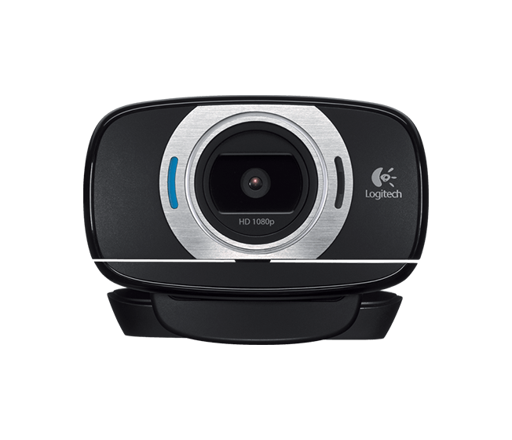
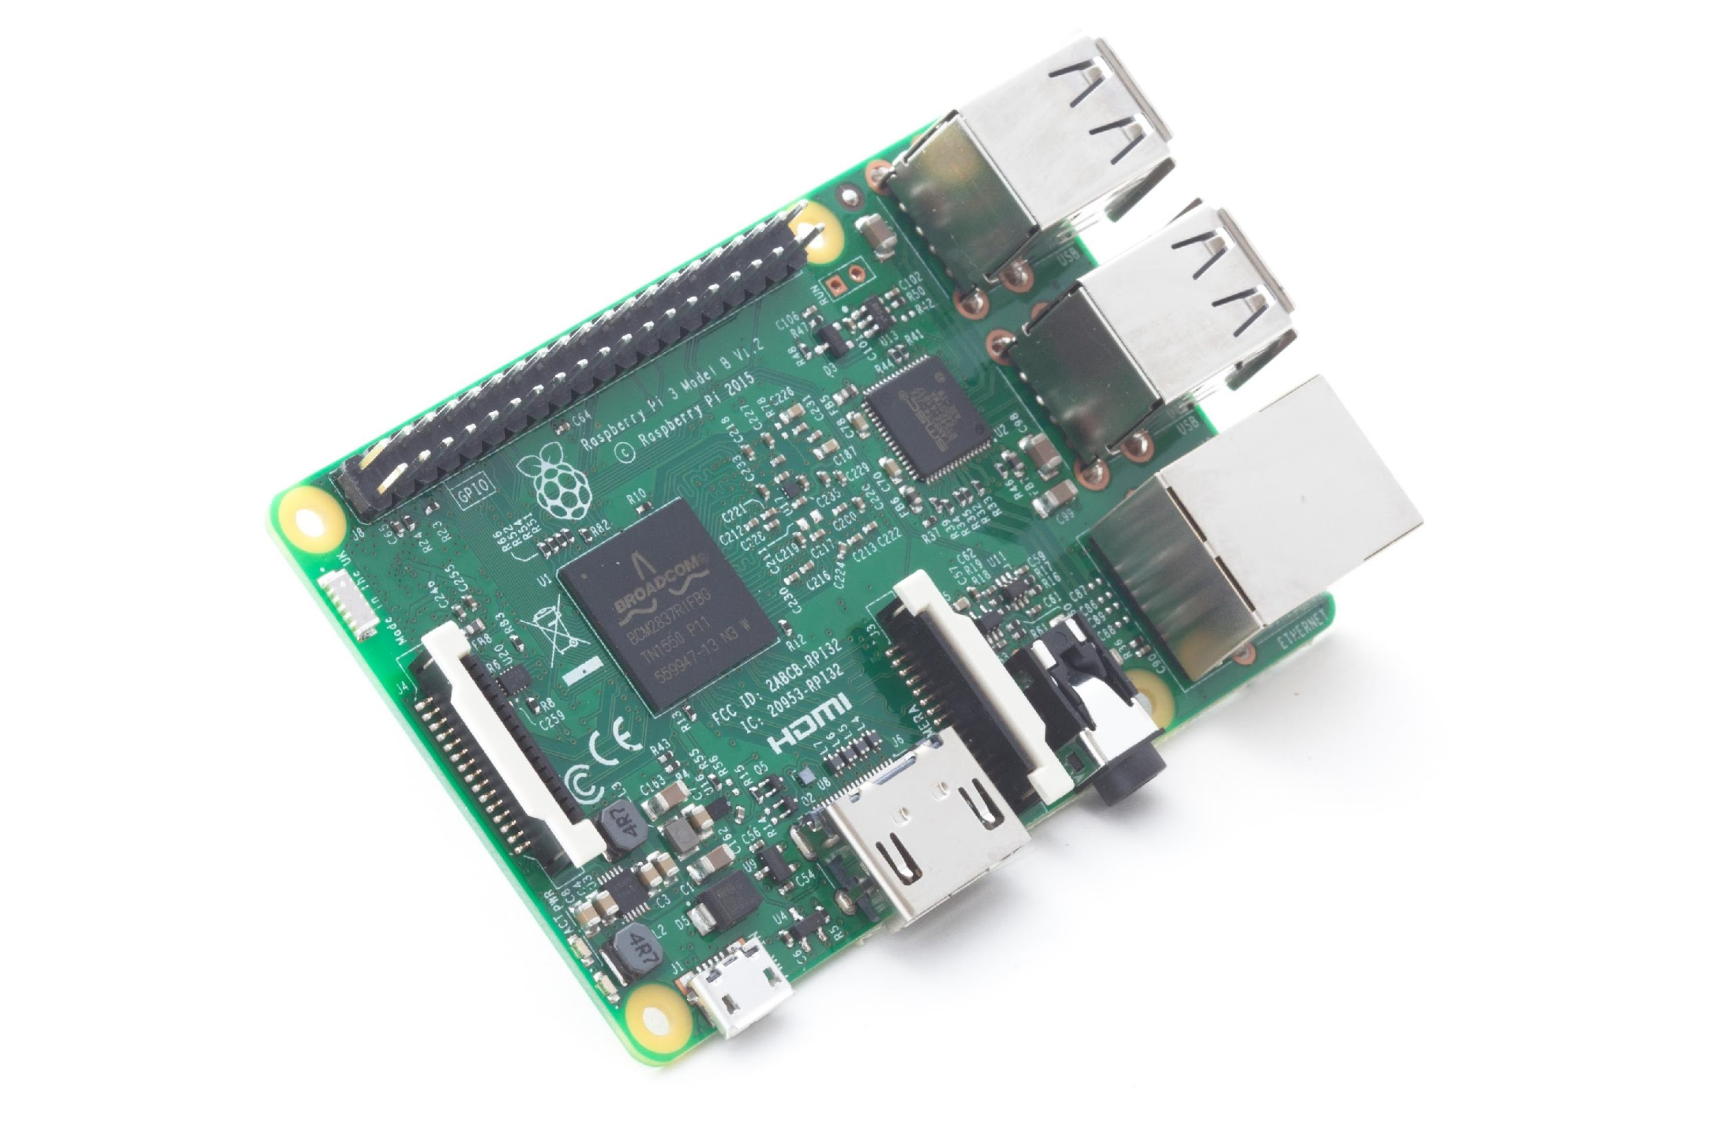
Example Robot
iRobot Create 1
Raspberry Pi 3 ARM Computer
Dual Webcams
Power Converter
Camera Mast and Cover
Exposes two services
iRobot Create control
Webcam control and acquisition

Slide 11
iRobot Create Service Definition
#Service to provide sample interface to the iRobot Create
service experimental.create2
stdver 0.9
struct SensorPacket
field uint8 ID
field uint8[] Data
end
object Create
constant int16 DRIVE_STRAIGHT 32767
constant int16 SPIN_CLOCKWISE -1
constant int16 SPIN_COUNTERCLOCKWISE 1
function void Drive(int16 velocity, int16 radius)
function void StartStreaming()
function void StopStreaming()
property int32 DistanceTraveled [readonly]
property int32 AngleTraveled [readonly]
property uint8 Bumpers [readonly]
event Bump()
wire SensorPacket packets [readonly]
callback uint8[] play_callback(int32 DistanceTraveled, int32 AngleTraveled)
end

Slide 12
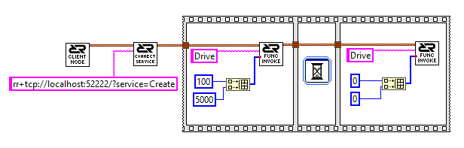
Example Clients
from RobotRaconteur.Client import *
import time
obj=RRN.ConnectService('rr+tcp://localhost:52222/?service=Create')
obj.Drive(100,5000)
time.sleep(1)
obj.Drive(0,0)
Python
o=RobotRaconteur.Connect('rr+tcp://localhost:52222/?service=Create');
o.Drive(int16(100),int16(5000));
pause(1);
o.Drive(int16(0),int16(0));
MATLAB
LabVIEW

Slide 13
Minimal Service Example
import RobotRaconteur as RR
RRN=RR.RobotRaconteurNode.s
import threading
import serial
import struct
minimal_create_interface="""
service experimental.minimal_create
object create_obj
function void Drive(int16 velocity, int16 radius)
end object
"""
class create_impl(object):
def __init__(self, port):
self._lock=threading.Lock()
self._serial=serial.Serial(port=port,baudrate=57600)
dat=struct.pack(">4B",128,132,150, 0)
self._serial.write(dat)
def Drive(self, velocity, radius):
with self._lock:
dat=struct.pack(">B2h",137,velocity,radius)
self._serial.write(dat)
#Create and register a transport
t=RR.TcpTransport()
t.StartServer(52222)
RRN.RegisterTransport(t)
#Register the service type
RRN.RegisterServiceType(minimal_create_interface)
create_inst=create_impl("/dev/ttyUSB0")
#Register the service
RRN.RegisterService("Create","experimental.minimal_create.create_obj",create_inst)
#Wait for program exit to quit
raw_input("Press enter to quit")

Slide 14
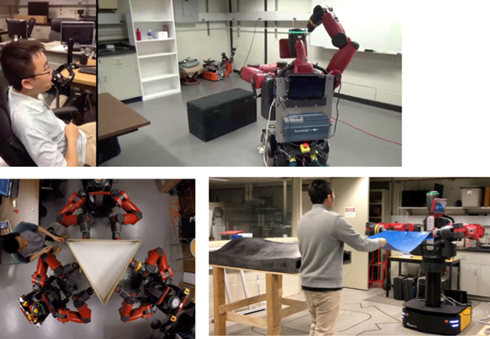
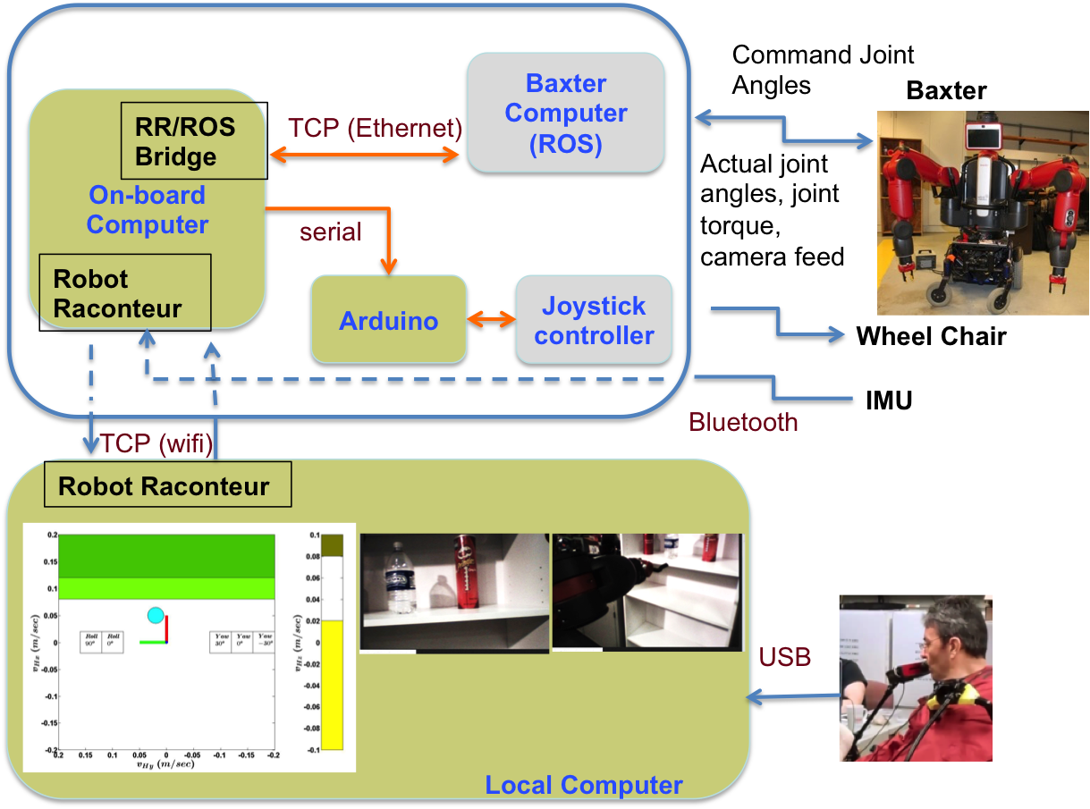
Baxter on Wheels
Baxter robot with Wheelchair
Used with a JamBoxx controller for disabled support experiments
Center for Automation Technology and Systems, Rensselaer Polytechnic Institute, Troy NY

Slide 15
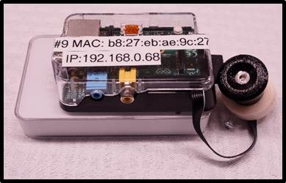
Smart Conference Room
Designed to test next-generation lighting control algorithms
Color-tunable lights
Light color sensors
Depth cameras
Climate control
Uses Robot Raconteur for communication between components
Smart Lighting Engineering Research Center, Rensselaer Polytechnic Institute, Troy, NY

Slide 16
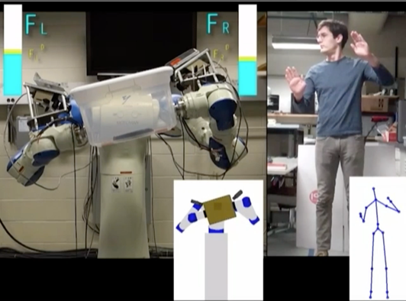
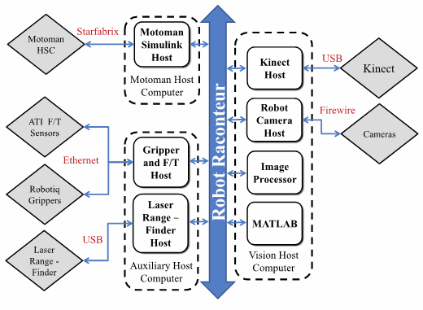
Human Guided Dual-Arm Manipulation

Slide 17
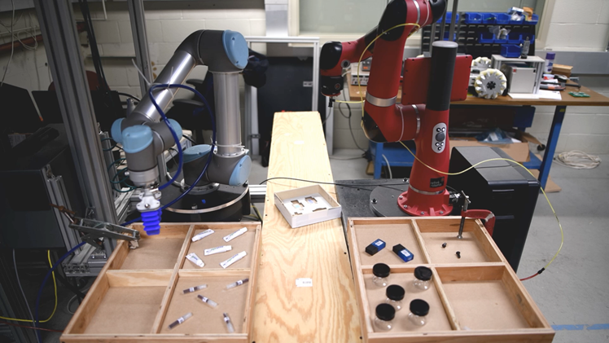
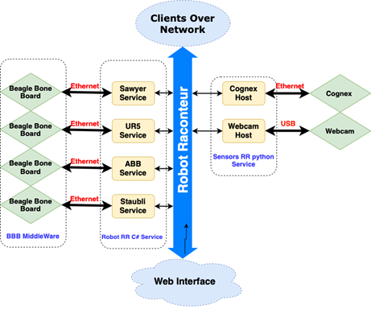
Multi-Robotic Testbed

Slide 18
Robot Raconteur Libraries
Robot Raconteur libraries come in 3 flavors:
RobotRaconteur Core – standard library written in C++ using Boost ASIO, wrapped with multiple languages using SWIG
RobotRaconteurWeb – Pure C# implementation intended for use with Web Browsers, ASP.NET servers and on Xamarin mobile framework
JavaScript available using Bridge.NET C# to JavaScript compiler
RobotRaconteurLite – ANSI C99 minimalist implementation intended for real-time and embedded systems
Still under early development, will be pushed to github in a week or two

Slide 19
RR Service Browser

Slide 20
Exercise 1: Running Python Example
Start by downloading Robot Raconteur for python 3 if you haven’t already as instructed here:
https://github.com/robotraconteur/RobotRaconteur_Python_Examples
Install also the Robot Raconteur Service Browser using the instructions shown here:
https://github.com/robotraconteur/RobotRaconteur_ServiceBrowser
In this exercise you will edit the file SimpleWebcamService.py to only use one webcam, this will allow the service to use an integrated or USB webcam connected to your computer to capture images.
Run SimpleWebcamService.py
Verify that the Service has been started by running the Robot Raconteur Service Browser in a separate command window
Run SimpleWebcamClient.py with the URL seen in the Service Browser to view the images captured by the webcam

Slide 21
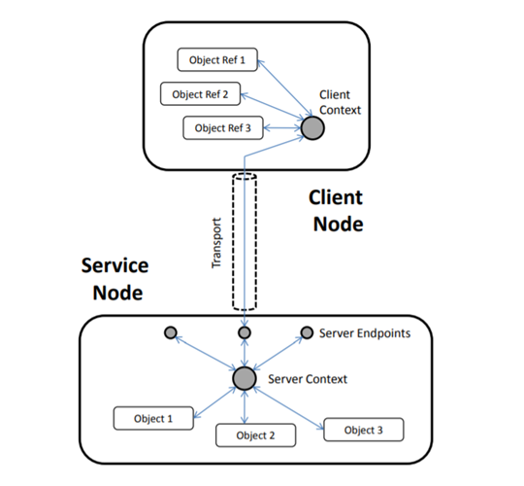
Functional Model of RR Nodes
Here the service node is launched and declares a number of members and methods
The service node establishes endpoints that the client node can connect to
Once connected the service members can be referenced as if they belong to the client
Multiple clients can connect to a service node using different endpoints

Slide 22
Robdef Files
A Robdef file is a service definition file that outlines the different members in the service
Robdef Files are used to define the service interface sent from service node to client node
Robdef files can be made using any text editor and can be customized easily, but members and functions in the Robdef services should be defined in the accompanying service file
A custom Robdef is good for new devices and temporary interfaces, but to allow a device to be interoperable with other similar devices it should use the Robot Raconteur Standard Robdefs

Slide 23
Example Robdef File
#Service to provide sample interface to the iRobot Create
service experimental.create2
stdver 0.9
struct SensorPacket
field uint8 ID
field uint8[] Data
end
object Create
constant int16 DRIVE_STRAIGHT 32767
constant int16 SPIN_CLOCKWISE -1
constant int16 SPIN_COUNTERCLOCKWISE 1
function void Drive(int16 velocity, int16 radius)
function void StartStreaming()
function void StopStreaming()
property int32 DistanceTraveled [readonly]
property int32 AngleTraveled [readonly]
property uint8 Bumpers [readonly]
event Bump()
wire SensorPacket packets [readonly]
callback uint8[] play_callback(int32 DistanceTraveled, int32 AngleTraveled)
end

Slide 24
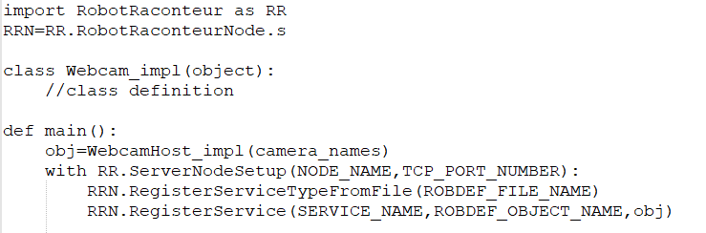
Starting a Service
Service object must be given a class object that defines Robdef functions and members
You specify a unique node name and TCP port number for the service to be advertised under
Import the robdef used by the service
Register the class object with a service name and the desired Robdef object type

Slide 25
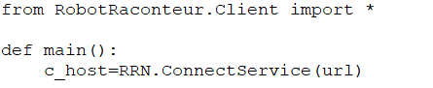
Starting a Client
Starting a client is SIGNIFICANTLY easier
You simply need the IPv6 address of the computer the service is on, its TCP port number and the service’s name
All details of the service’s functions and members are sent by the service and can immediately be accessed
Some services can be security protected and require additional information to connect

Slide 26
Robot Raconteur Properties
RR Properties function similar to class variables
RR Properties can be written to (set) or read from (get) by the client
RR Properties can be any of a number of value types and are owned by the RR objects that they are defined under
Declared using the property keyword followed by the value type then the name of the property
Properties can be made readonly or writeonly to control their access
Example Property definition in Robdef:
property double myvar [readonly]

Slide 27
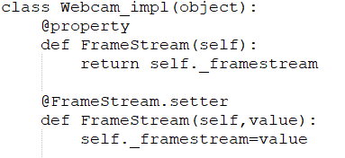
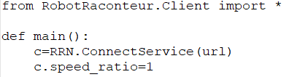
Robot Raconteur Properties Example
Service Side
Client Side

Slide 28
Robot Raconteur Functions
Functions take zero or more input value types and return a single value type
The return value can be void and every input value must have a unique name
A function is declared using the function keyword followed by the return type then the name of the function and the types and names of the input values
Example Function definition in Robdef:
function double addTwoNumbers(int32 a, double b)

Slide 29
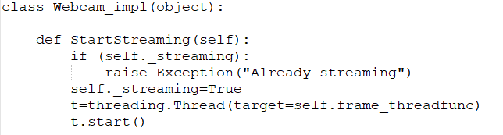
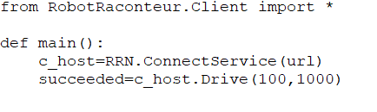
Robot Raconteur Functions Example
Service Side
Client Side

Slide 30
Exercise 2: Adding a New Property
Using the SimpleWebcamService.py file and its accompanying Robdef, modify them to have a new property Framerate that uses the python Time.now to record the amount of time between frames and set it as a property that can be read from and printed by the SimpleWebcamClient.py
First you must add the property to the Robdef, then you must modify the capture callback used to continually capture from the webcam to use two class variables to set a third class variable that is returned by the get method of the service

